Slide 1


Class 10 Political Science
Chapter 6
By-
SK Shandilya

Slide 2



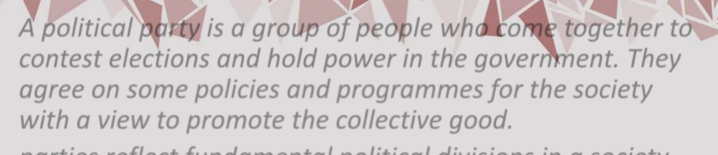

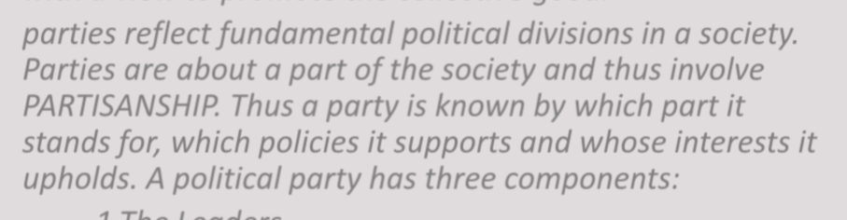



1.The Leaders
2.The Active Members and
3.The Followers

Slide 3



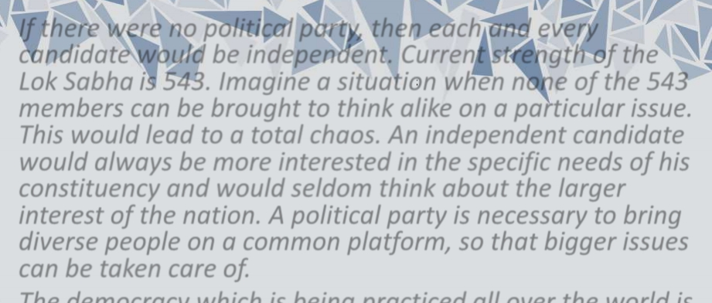

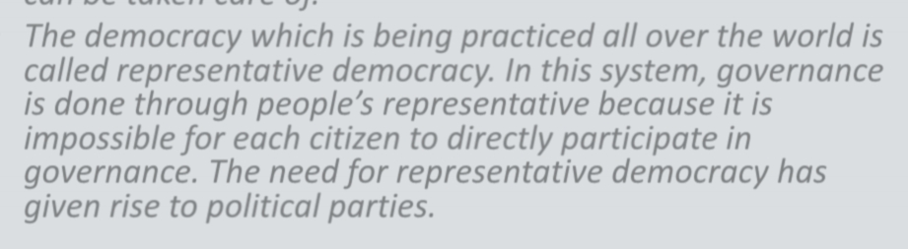

Slide 4
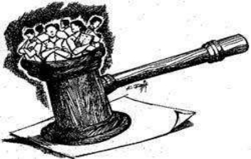


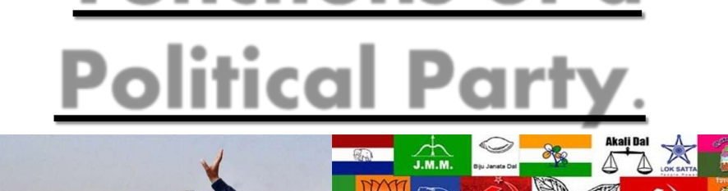
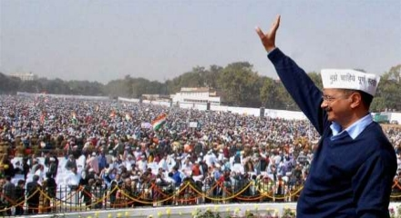
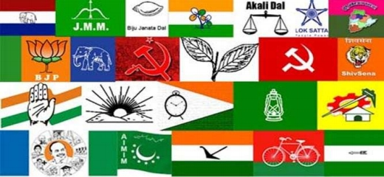

Slide 5
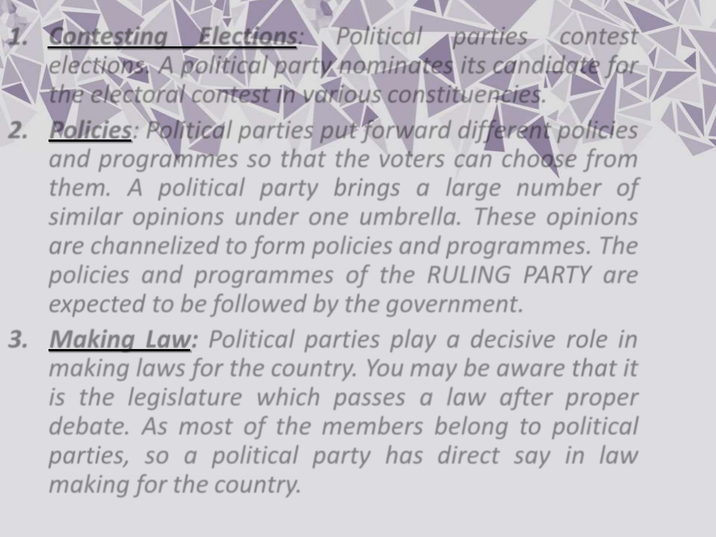
1. Contesting Elections: Political parties contest elections. A political party nominates its candidate for the electoral contest in various constituencies.
2. Policies: Political parties put forward different policies and programmes so that the voters can choose from them. A political party brings a large number of similar opinions under one umbrella. These opinions are channelized to form policies and programmes. The policies and programmes of the RULING PARTY are expected to be followed by the government.
3. Making Law: Political parties play a decisive role in making laws for the country. You may be aware that it is the legislature which passes a law after proper debate. As most of the members belong to political parties, so a political party has direct say in law making for the country.

Slide 6
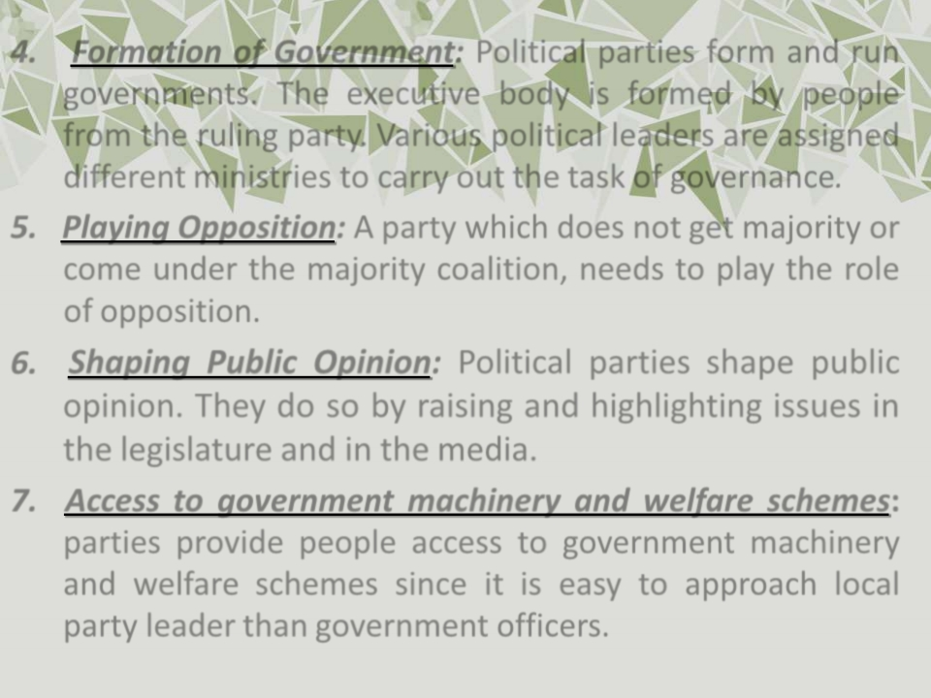
4. Formation of Government: Political parties form and run governments. The executive body is formed by people from the ruling party. Various political leaders are assigned different ministries to carry out the task of governance.
5. Playing Opposition: A party which does not get majority or come under the majority coalition, needs to play the role of opposition.
6.
Shaping Public Opinion: Political parties shape public opinion. They do so by raising and highlighting issues in the legislature and in the media.
7. Access to government machinery and welfare schemes: parties provide people access to government machinery and welfare schemes since it is easy to approach local party leader than government officers.

Slide 7
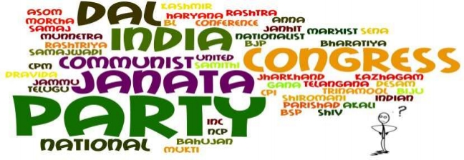
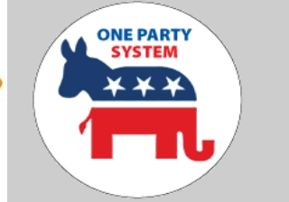


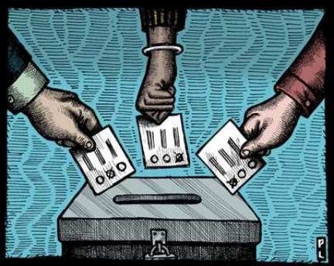
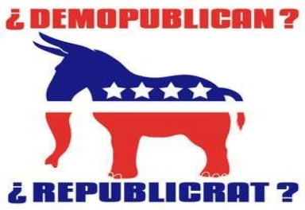

Slide 8









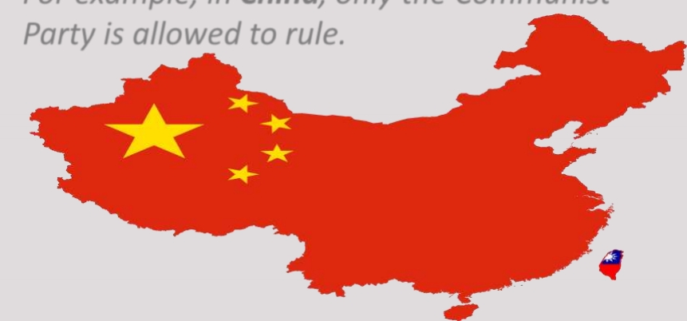
One party system • In some countries, only one party I s allowed
to control and run the government. These are called one party systems.
• For example, in China, only the Communist Party is allowed to rule.

Slide 9







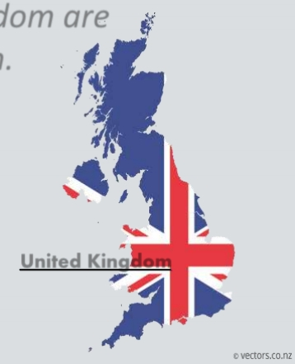



Two-party system
• In some countries, power is shared between two main parties. Such party system is called two party system. The United States of America and the United Kingdom are examples of two party system.
United Kingdom
United States of America

Slide 10











Multi party system
• If several parties compete for power, and more than two parties have reasonable chance of winning, we call it a multi party system. In India we have a multi party system.
Since multi party system tend to offer more choices to the voters, it is often considered better than the other party systems.

Slide 11



Comparison between two party
and multiple party system
Two party system | Multi party system
The two-party system presents voters a simple choice. | Multi party system provides voters with many choices.
This provides for stable governance. | Government is not stables in this system
Two-party systems are not as flexible because they have a more or less rigid set of opinions on every issue. | A multi-party system is more responsive to a change or shift in public opinion.
Examples : USA and UK | Example: India

Slide 12















National parties
• A party that secures at least six per cent of total votes in Lok Sabha elections or Assembly elections in four States and wins at least four seats in the Lok Sabha is recognized as a national party.

Slide 13
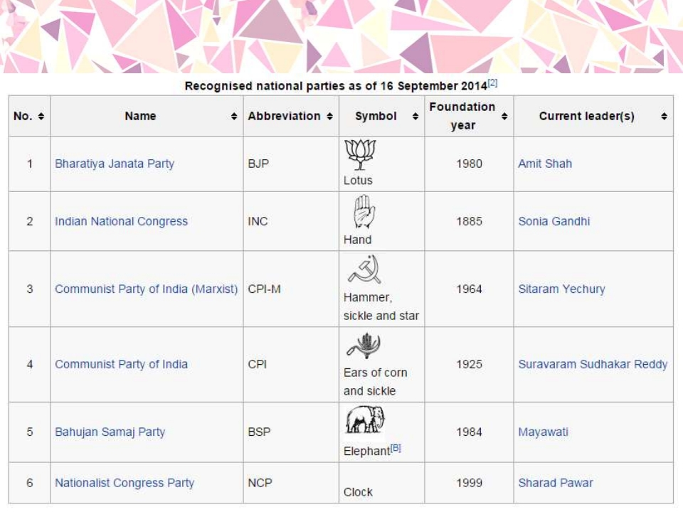

Recognized national parties in India

Slide 14








State parties
• A party that secures at least 6 per cent of the total votes in an election to the Legislative Assembly of a State and wins at least two seats is recognized as a State party.

Slide 15
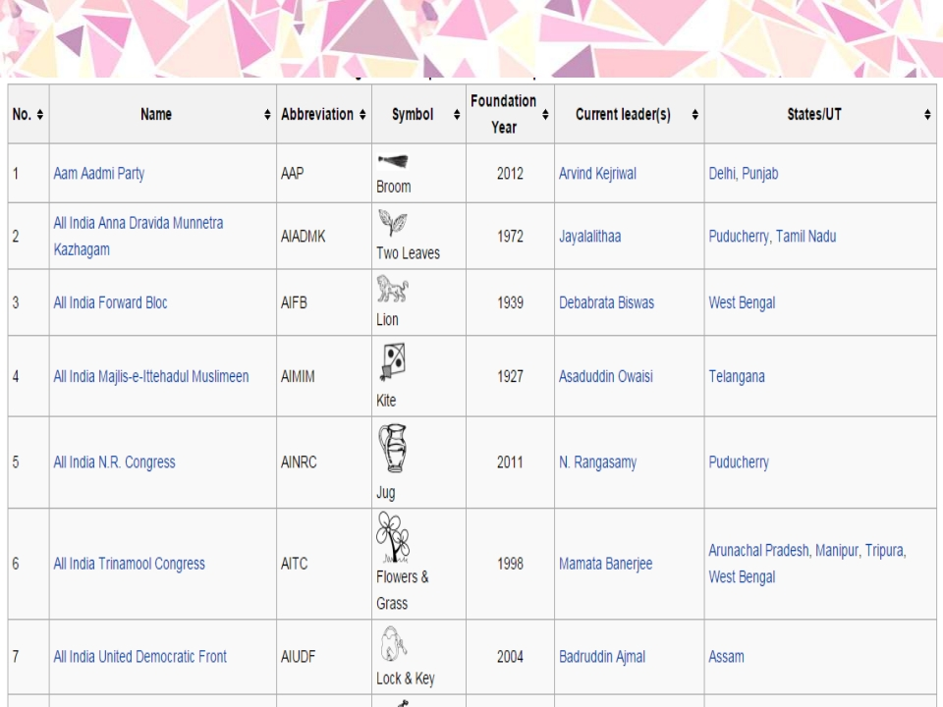

Recognized state parties in India

Slide 16
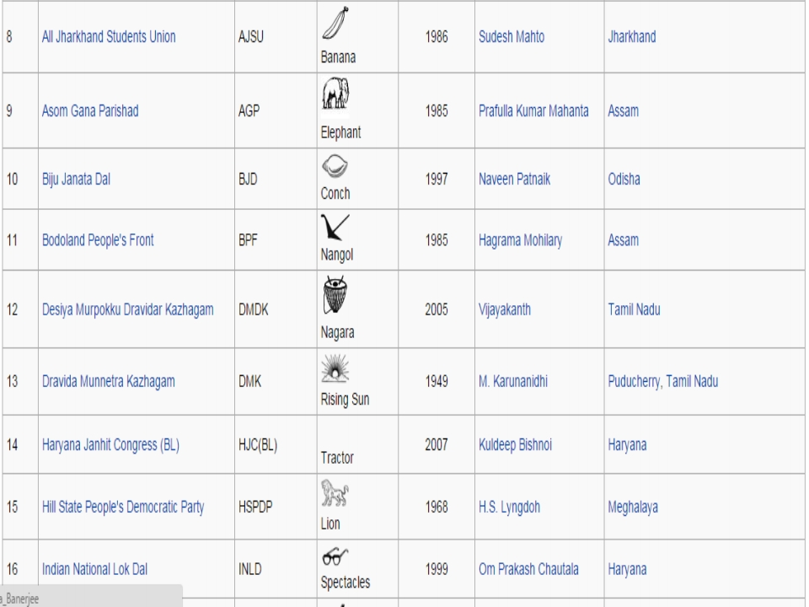

Slide 17
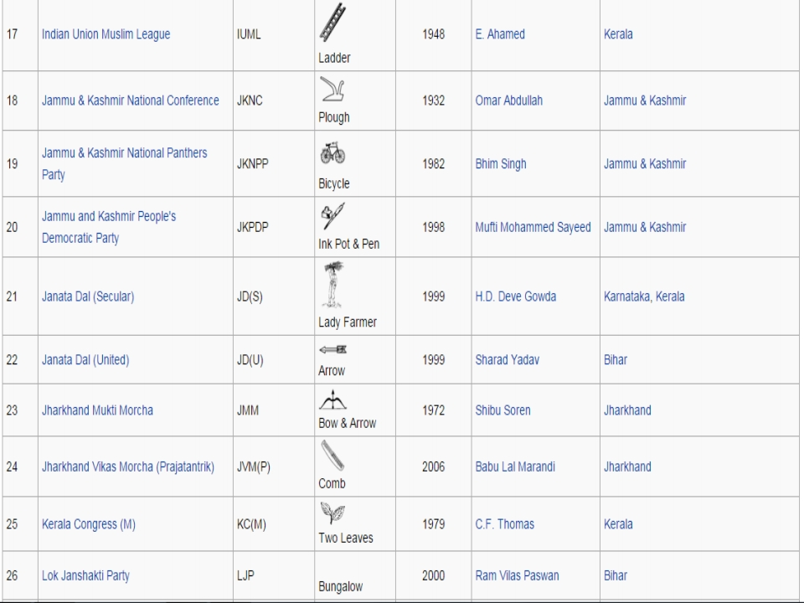

Slide 18
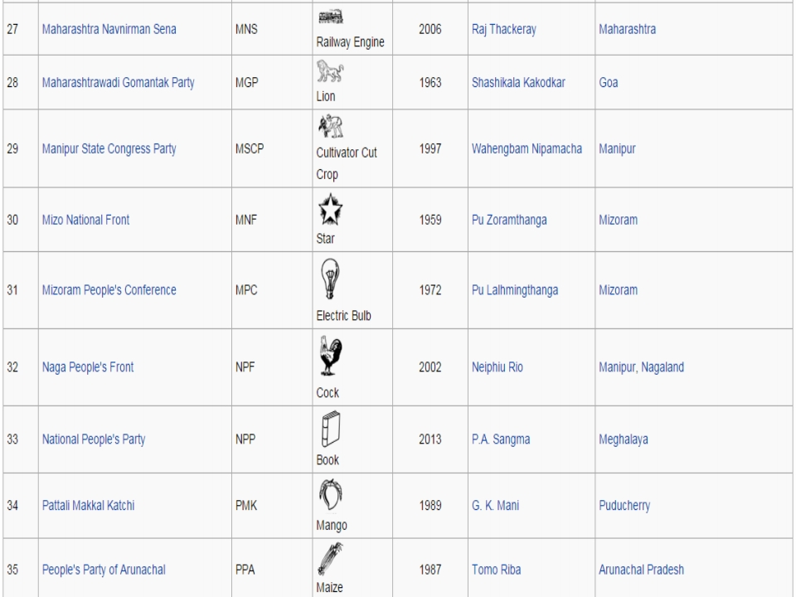

Slide 19
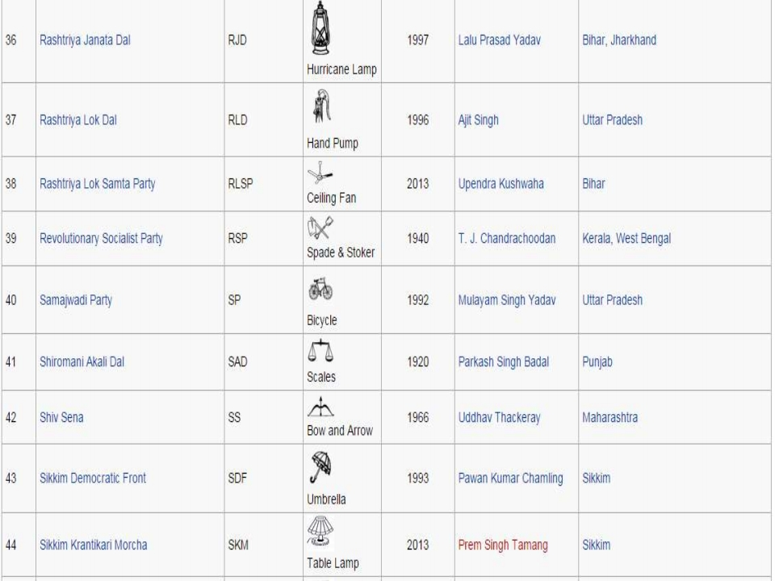

Slide 20
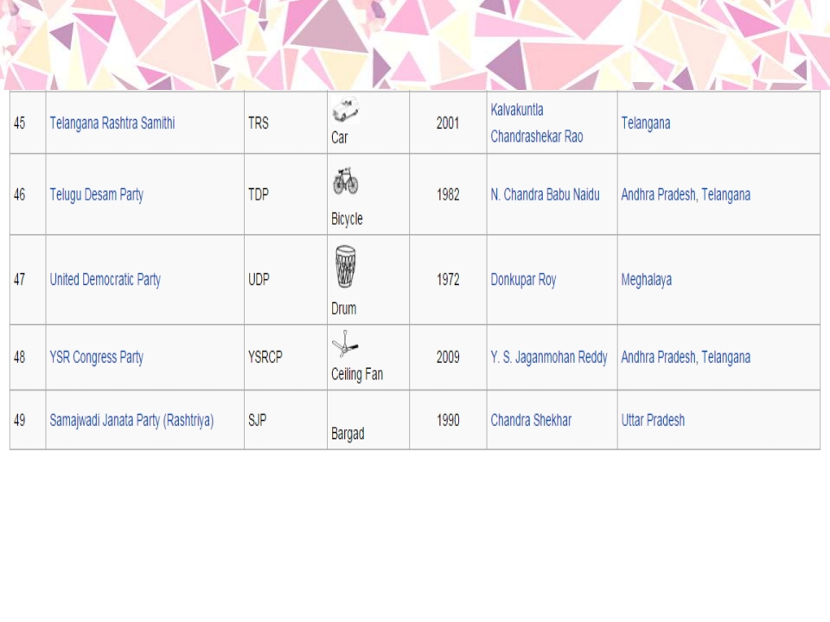

Slide 21
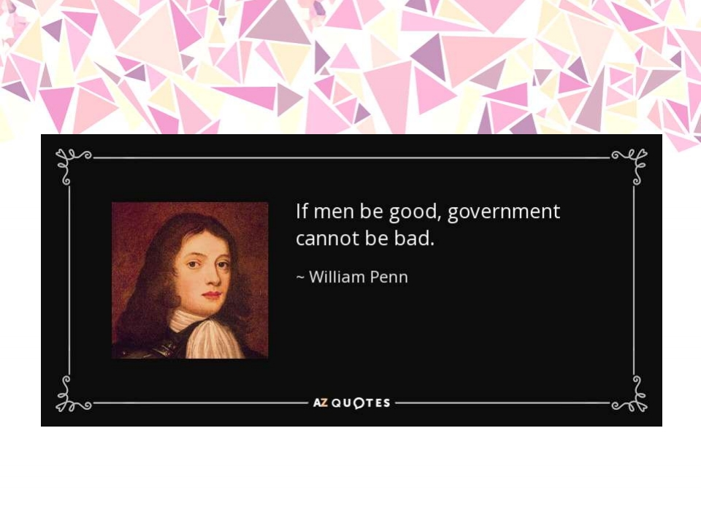

Slide 22


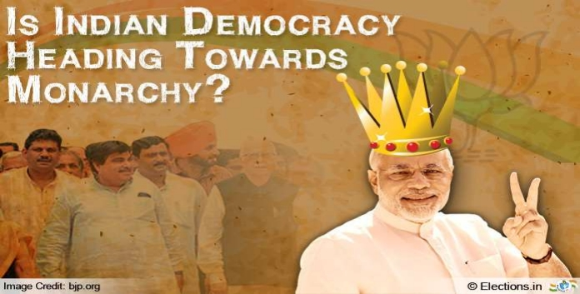
Challengestoa
PoliticalParty.

Slide 23
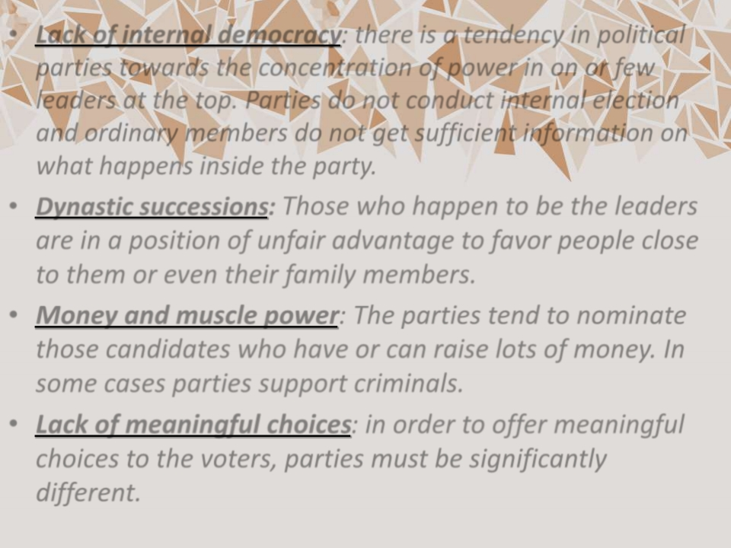
• Lack of internal democracy: there is a tendency in political parties towards the concentration of power in on or few leaders at the top. Parties do not conduct internal election and ordinary members do not get sufficient information on what happens inside the party.
• Dynastic successions: Those who happen to be the leaders are in a position of unfair advantage to favor people close to them or even their family members.
• Money and muscle power: The parties tend to nominate those candidates who have or can raise lots of money. In some cases parties support criminals.
• Lack of meaningful choices: in order to offer meaningful choices to the voters, parties must be significantly different.

Slide 24
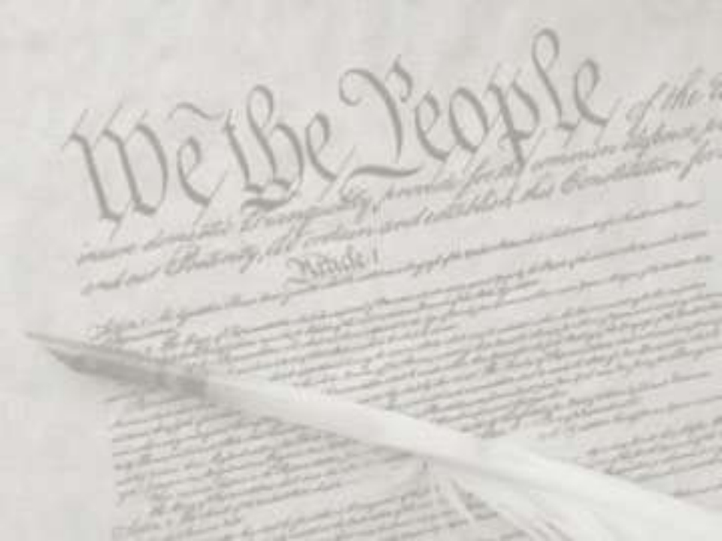
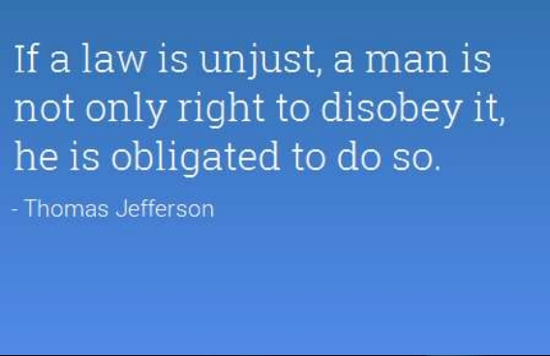

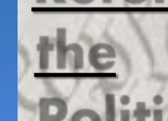

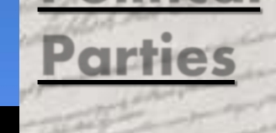
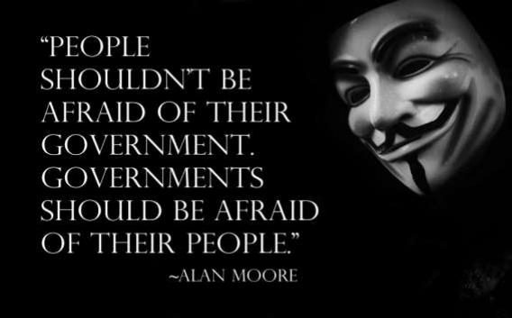
Reforming
the
Political
Parties

Slide 25










• The constitution was amended to prevent elected members from changing parties. This was done because many elected representatives were indulging in defection in order to become minister or for cash rewards.
• The supreme court passed an order to reduce the influence of money and criminals. Now, it is mandatory for every candidate who contests election to file affidavit giving details of his property and criminal cases pending against him.
• The election commission passed an order making it necessary for political parties to hold their organizational elections and file their income tax returns.
• A law should be made to regulate the internal affairs of political parties.

Slide 26






• It should be made mandatory for political parties to give minimum number of tickets, about one third of tickets, to women candidates.
• There should be state funding of elections. The government should give parties money to support their election expenses.

Slide 27
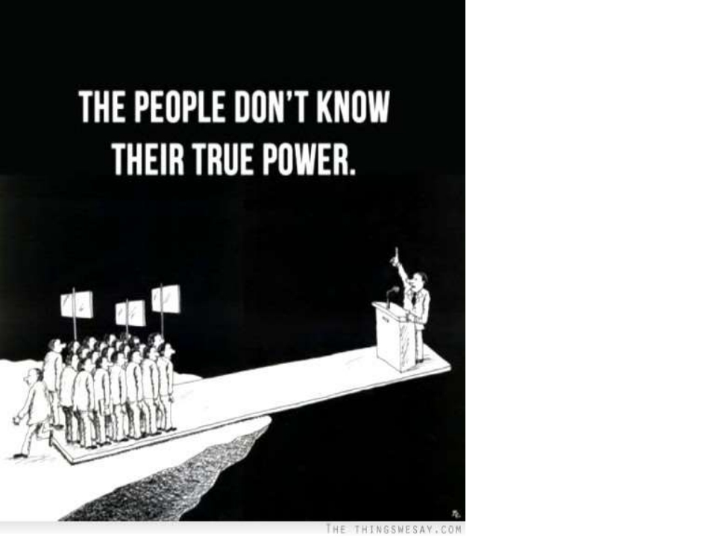


Thank
You !

